Slide 1

Hospitalized patients with heart failure

Slide 2
Contents
Background
Problem Statement
Project Objectives
Dataset Information
Dataset
Data exploration and Visualizations
Challenges
References

Slide 3
Background
Elderly hospitalizations are frequently followed by heart failure, which is linked to high mortality and morbidity. Over 6 million Americans are afflicted by the illness, and the incidence rate among the elderly is estimated to be 21 per 1000 [1, 2].
In accordance with comorbidities and co-existing medical problems, studies have shown that mortality rate at 1 year ranges from 20% to 60% after hospitalization for acute heart failure [3-6].
To facilitate research on heart failure hospital patients, many datasets have been created. A common dataset used in clinical trials is the Cleveland in Heart Disease dataset, which has 75 variables and 303 individuals.

Slide 4
Problem Statement
We would like to identify the factors that causes heart failure in hospitalized patients. So, that we can start treatment if they are undiagnosed & affected.
Moreover, we would like to know what type of affected patients have more probability to get heart failure than others.

Slide 5
Problem Objective
Our goal is to find patients who are more vulnerable to heart attack with & without any existing any health conditions and how it can be prevented.
Inaddition, we would like to know find which gender is more vulnerable to heart attack.
We would also like to know the death rate of the patients after getting discharged from hospital after getting a heart attack.

Slide 6
Dataset
Dataset file contains a record of the medications that were given throughout the hospital stay. The number of entries in the table indicates that a drug was given more than once even though administration times are not provided.
Our dataset contained the following main pharmacological classes: diuretics(water pills), inotropes, and vasodilators(dilate blood vessel) etc.
Inotropes are drugs that tell r heart muscles to beat or contract with more or less power.

Slide 7
Data Cleaning:
The dataset had multiple categories like demographics, baseline health characteristics, use of drugs and lab findings.
Dataset has lot of irregularities and inconsistencies and needed cleaning for a better understanding and analyzation.
In addition, they were so many missing values present in it.
The data cleaning was done using excel.

Slide 8
Data Cleaning:
We replaced data entries from 0 and 1 to Yes and No.
Certain attributes were removed as they were not required and had no real impact to the analysis.
Certain attributes was easy to understand like age, respiratory rate, systolic(pressure blood is exerting) blood pressure etc. Others we’re way too complicated for that, we had to extensively research. For instance, the Killip grade which is used as a threshold for establishing the risk of mortality after assessing the patient’s physical examination and the factors that lead to heart attack.

Slide 9

Exploratory Data Analysis:

Slide 10
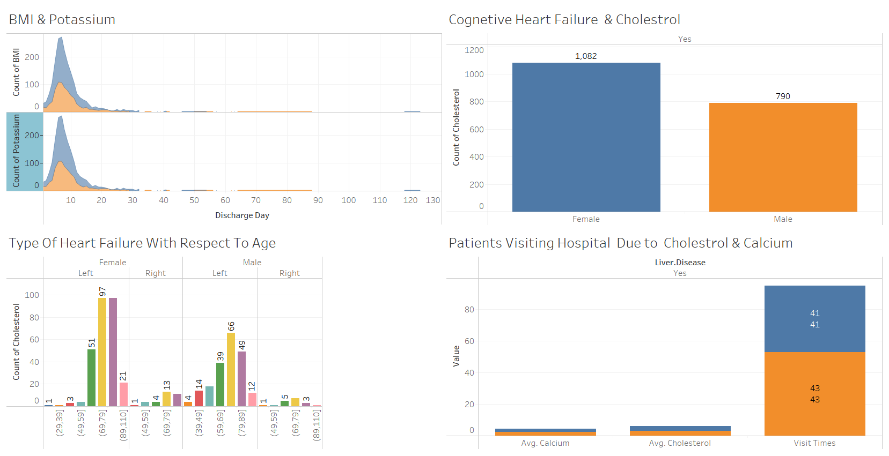
Comparison Of Health ailments Gender Wise

Slide 11
More number people are getting heart attack on left side are between the age 69-79 & followed by 79-89. Females of this age group are more at risk.
For cognitive heart failure chances of women are more .
More number of people visit hospital due to calcium and cholesterol ailments .
An ideal BMI for an adult man is between 18.5 and 24.9 and for female BMI: 18.5–24.9

Slide 12
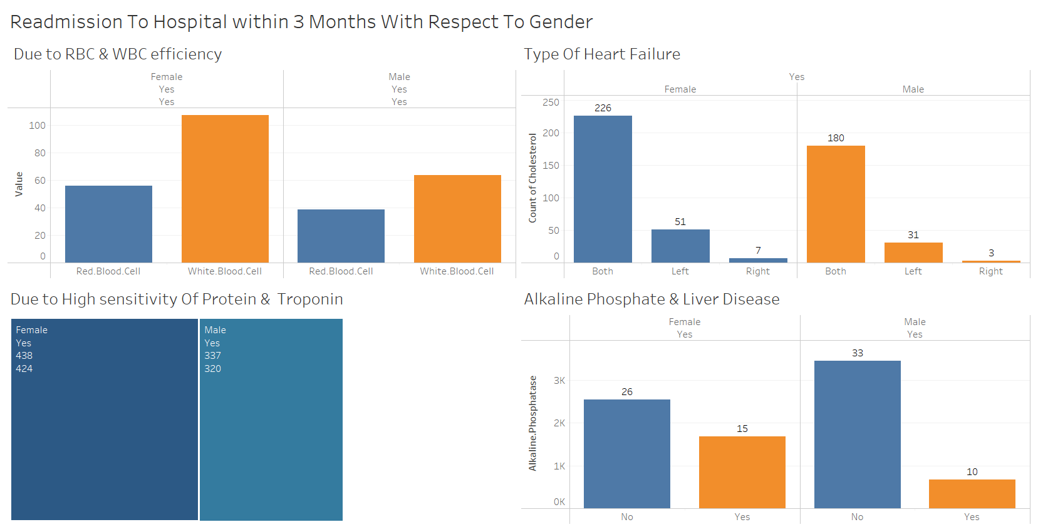
Readmission To Hospital within 3 Months With Respect To Gender

Slide 13
More number of females are getting readmitted to the hospital due to the deficiency of white blood cell than red blood cells.
728 females got readmitted within 3 months of getting discharge either due to left or right side ache of heart. Where as, men is at 545.
WBC average should be 4500 to 1100.
Normal range of troponin is 0 & 0.04.
Normal range of protein is 0.8gms/Kg of body wt.

Slide 14
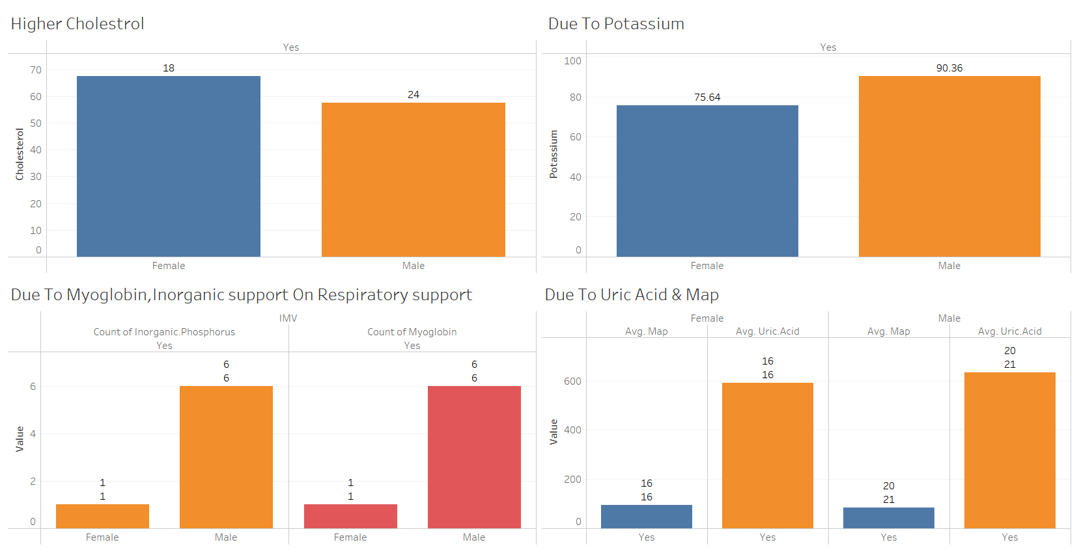
Death Rate Within 28 days Gender Wise

Slide 15
Based on gender wise women are more prone to die earlier compared to men not only with higher cholesterol with other diseases.
Men has more uric acid & map compared to women.
Blood potassium level is 3.6 to 5.2 millimoles per liter (mmol/L). A very low potassium level (less than 2.5 mmol/L ) can be life-threatening and requires urgent medical attention.
A total cholesterol level of less than 200 mg/dL (5.17 mmol/L) is normal.
Normal range of uric acid between 3.5 to 7.2 milligrams per deciliter (mg/dL)

Slide 16
Challenges
Selecting a appropriate dataset.
Disagreement between team members for selecting appropriate platform for performing the analysis.

Slide 17
Recommendations
It’s advisable for women aged 50 and above to check cholesterol whenever they visit hospital in order to avoid heart failure.
Men should get tested for uric acid frequently are there more prone to higher uric acid.
Always maintain a healthy lifestyle.

Slide 18
References
https://physionet.org/content/heart-failure-zigong/1.3/
HCUP National Inpatient Sample (NIS). Healthcare Cost and Utilization Project (HCUP). 2012. Agency for Healthcare Research and Quality, Rockville, MD. www.hcup-us.ahrq.gov/nisoverview.jsp
Al-Jarallah, M. et al. Incidence and impact of cardiorenal anaemia syndrome on all-cause mortality in acute heart failure patients stratified by left ventricular ejection fraction in the Middle East. ESC Heart Fail 6, 103–110 (2019).

